Slide 1
Medicine Recommendation System
From Symptoms to Solutions: AI-Powered Health Advisor

Slide 2
Team Members
K. K. Sai Lakshmi 22X45A4208
S. Lahari 21X41A4253
Ch. Karthik 22X45A4202
Guided By:
Ch. Rathna Jyothi

Slide 3
The medical recommendation system is an Ai-powered web application designed to help users identify potential diseases based on their symptoms. The system utilizes machine learning algorithms to analyze user-inputted symptoms, either through manual entry or speech recognition, and predict possible illnesses. Additionally, it offers comprehensive healthcare guidance, including disease descriptions, precautionary measures, medication suggestions, recommended workouts, and diet plans. This project aims to bridge the gap between patients and healthcare by providing quick, reliable, and easily accessible medical insights. By integrating natural language processing (NLP) for symptom recognition and deep learning models for disease prediction, the system enhances accuracy and efficiency. The platform is designed with a user-friendly interface, ensuring that people with minimal technical knowledge can easily navigate and benefit from its recommendations. This project aims to enhance healthcare accessibility by offering quick and reliable health insights, helping users make informed decisions before consulting a doctor.
ABSTRACT

Slide 4
Existing system
The existing medicine recommendation system primarily relies on manual consultations where doctors or pharmacists diagnose patients based on symptoms and prescribe medications accordingly. Some healthcare institutions use rule-based expert systems, which map symptoms to specific diseases and medicines using predefined medical databases, though they lack adaptability to new research. Additionally, online symptom checker platforms like WebMD, Ada, and Medscape offer symptom-based disease predictions and suggest over-the-counter (OTC) medicines using decision trees.
However, these systems often lack personalization, real-time adaptability, and deep learning capabilities, making AI-driven solutions more efficient and accurate for modern healthcare needs.
Challenges of Existing System:
Accuracy and Reliability – Ensuring precise disease diagnosis and medicine recommendations is critical, as errors can lead to severe health risks.
Data Quality and Availability – Medical data needs to be accurate, up-to-date, and diverse to train AI models effectively, but access to high-quality data is often limited.
Handling Rare or Unknown Diseases – AI models may struggle with rare diseases or new medical conditions due to a lack of sufficient training data.

Slide 5
Proposed system
The proposed system for your Medicine Recommendation System aims to enhance the accuracy and efficiency of medical advice using AI-driven technology. Unlike traditional manual consultation methods, this system allows users to input their symptoms (via text or speech recognition) and receive AI-generated predictions for potential diseases along with recommended medications, precautions, workouts, and diets. The system leverages machine learning algorithms to analyze symptoms, compare them with a vast medical dataset, and provide personalized recommendations. By integrating speech recognition, it improves accessibility for users with limited typing ability. This AI-based approach ensures faster, more reliable, and data-driven medical guidance, making healthcare more accessible and efficient.
ADVANTAGES
Faster Diagnosis – AI quickly analyzes symptoms and provides potential disease predictions, reducing the time required for consultations.
24/7 Accessibility – Users can access the system anytime and anywhere, making healthcare more convenient and efficient.
Speech Recognition Integration – Enables users to input symptoms through voice, improving accessibility for those with difficulty typing.
AI-Powered Accuracy – Uses machine learning models to improve prediction accuracy over time by learning from medical data.
Cost-Effective Healthcare – Reduces unnecessary hospital visits, saving both time and money for users.
User-Friendly Interface – The system provides a simple and intuitive design, making it easy for anyone to use.

Slide 6
HARDWARE REQUIREMENTS
Processor : Intel Core i7
Ram : 8 GB
Hard Disk : 256 GB SSD
Monitor : 15” COLOR
Keyboard : STANDARD 102 KEYS
Mouse : 3 BUTTON

Slide 7
Software requirements
Operating System : Windows
Python : version 3.8 or higher
Libraries : scikit-learn, pandas, numpy, matplotlib, nltk
IDE : Jupyter Notebook or PyCharm

Slide 8
Modules of the project
USER MODULES
This is the part of the system that the end-user (patients or general users) interact with. It includes the following features:
a. Symptom Input
Users can manually type symptoms (e.g., itching, fever, headache, etc.).
There is an option for speech recognition to input symptoms using voice.
b. Disease Prediction
Once symptoms are entered, the system processes the input and predicts possible diseases.
The system uses AI/ML algorithms to match symptoms with known diseases.

Slide 9
c. AI System Results
After predicting the disease, the system displays results under different categories:
Disease Information → Displays the name and details of the predicted disease.
Description → Gives an overview of what the disease is.
Precaution → Suggests preventive measures to avoid worsening the condition.
Medications → Recommends medicines that can help treat the condition.
Workouts → Suggests physical exercises beneficial for the condition.
Diets → Provides dietary recommendations suitable for the disease.
This module ensures that the user receives all the necessary information about their symptoms without needing a doctor immediately.

Slide 10
ADMIN MODULE
Even though there is no admin login, the backend of the system performs important administrative tasks. This includes:
a. Database Management
Stores symptoms, diseases, medicines, workouts, and diet recommendations.
Maintains a mapping between symptoms and diseases for accurate predictions.
b. Machine Learning Model
Processes user symptoms and predicts the most likely disease.
Uses trained AI/ML models to analyze and compare data.
c. Speech Recognition
Converts voice input into text and processes it as symptoms.

Slide 11
d. Prediction Logic
Matches the input symptoms with existing disease data.
Uses predefined rules or AI-based models for prediction.
e. Result Generation
Fetches disease information from the database and presents it in a user-friendly format.
Provides recommendations for medication, diet, and exercise.

Slide 12
LITERATURE SURVRY
TITLE | AUTHOR | YEAR | OUTCOMES | DESCRIPTION
Machine Learning-Based Sentiment Analysis of Drug Reviews for Drug Rating and Recommendation | Md. Deloar Hossain | 2020 | our system effectively analyzes drug reviews to predict sentiments and offers personalized drug recommendations | It helps in understanding how effective a drug is by checking whether reviews are positive, negative, or neutral. Based on this analysis, it predicts drug ratings and provides recommendations for better alternatives
Machine Learning in Healthcare Informatics | Sumeet Dua and U. Rajendra Acharya | 2013 | Improved diagnostics are achieved through precise analysis of medical images and patient data, allowing for earlier and more accurate detection of anomalies such as tumors | By leveraging ML algorithms, healthcare professionals can improve decision-making, predict treatment outcomes, and personalize patient care

Slide 13
TITLE | AUTHOR | YEAR | OUTCOMES | DESCRIPTION
Explainable AI for Healthcare | Pradeep N. and Pethuru Raj | 2022 | Firstly, it enhances trust in AI systems by providing clear and understandable explanations for AI-driven decisions, making clinicians more likely to adopt these technologies | By making AI decisions interpretable, XAI helps clinicians validate and trust the AI's outputs, ensuring that these tools can be effectively integrated into patient care
Drug Recommendation System in Medical Emergencies using Machine Learning | Silpa et al | 2023 | it enhances the speed and accuracy of drug recommendations, ensuring that patients receive the most suitable medications promptly | This system analyzes patient data, including symptoms, medical history, and vital signs, to recommend the most appropriate drugs.

Slide 14
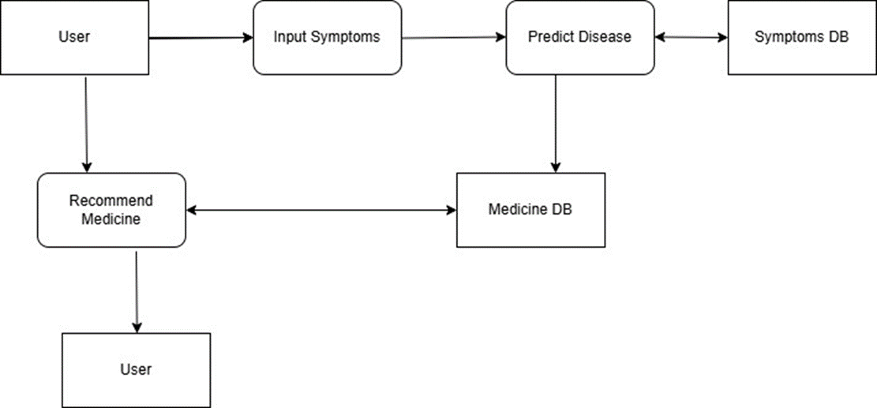
Uml diagrams
DATAFLOW DIAGRAM:

Slide 15
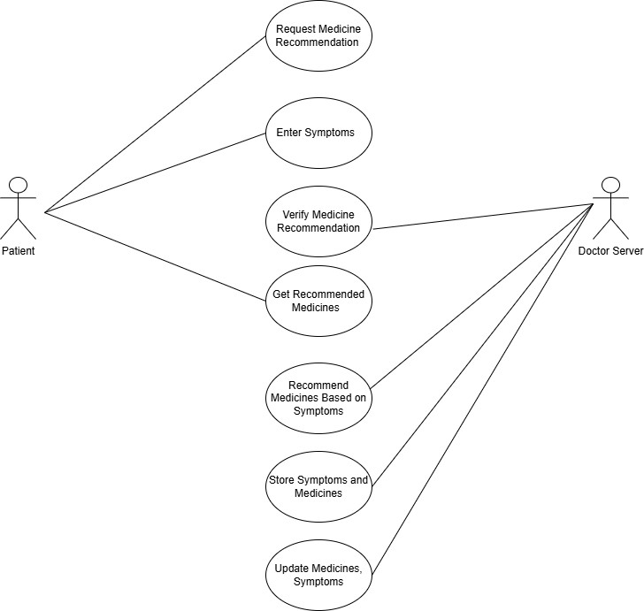
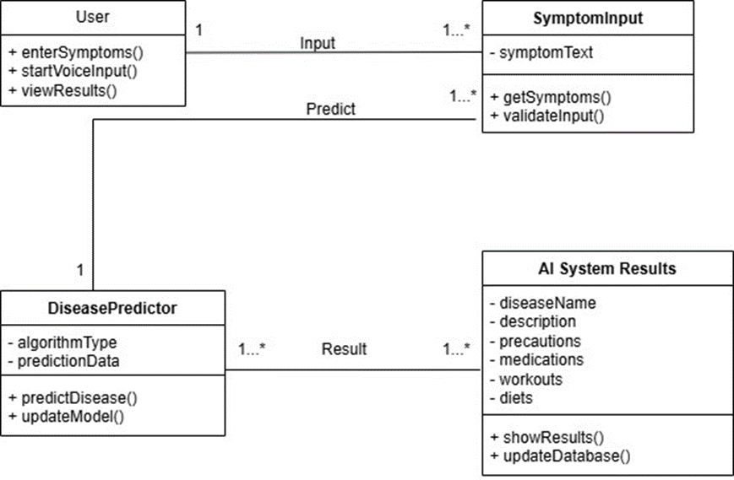
USE CASE DIAGRAM CLASS DIAGRAM

Slide 16
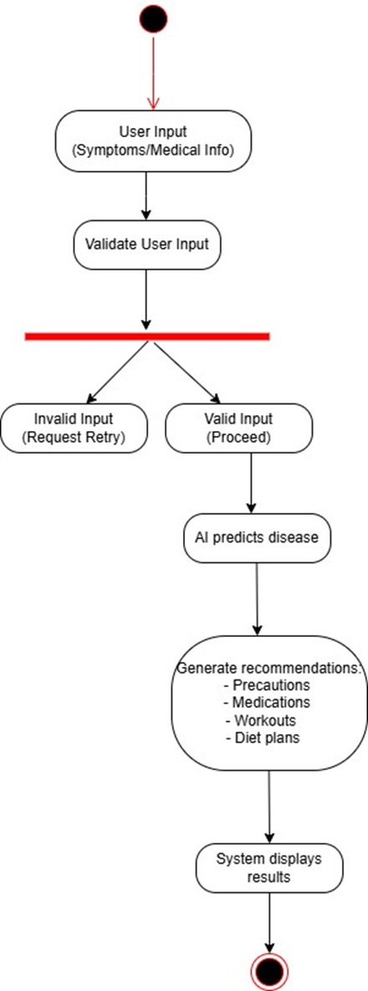
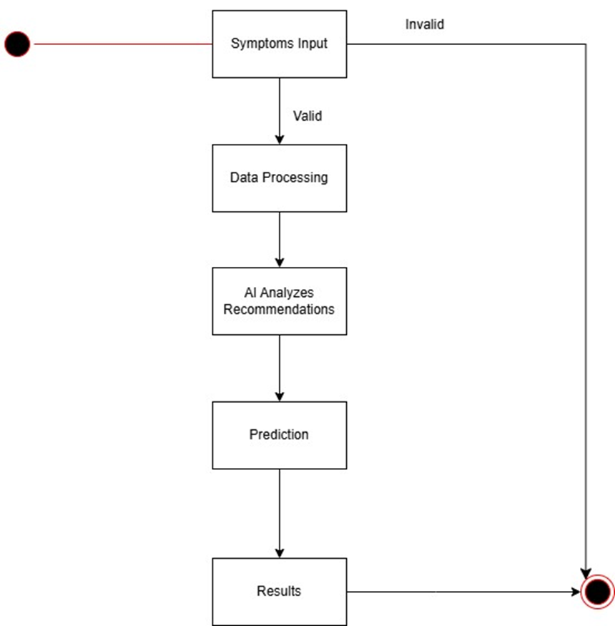
ACTIVITY DIAGRAM STATE MACHINE DIAGRAM

Slide 17
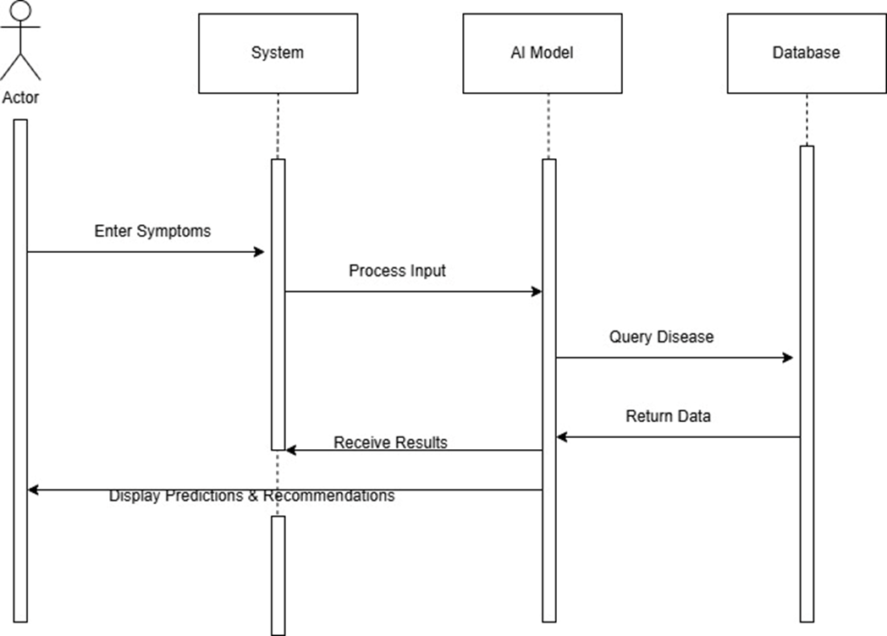
SEQUENCE DIAGRAM

Slide 18
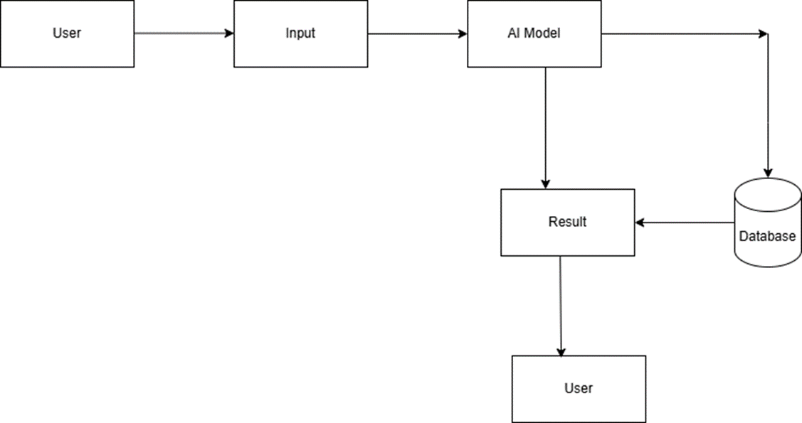
COMMUNICATION DIAGRAM

Slide 19
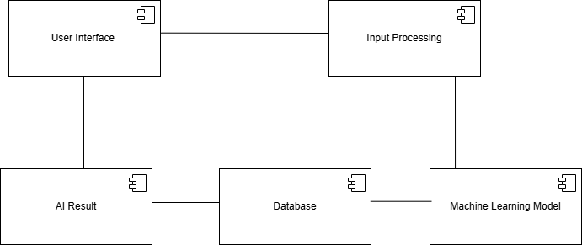
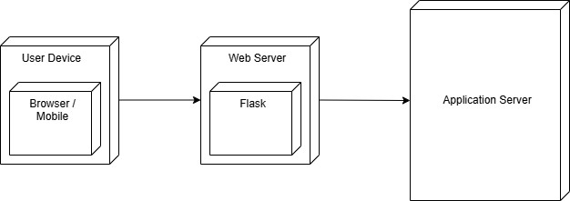
COMPONENT DIAGRAM DEPLOYMENT DIAGRAM

Slide 20
Thank you
K. K. Sai Lakshmi 22X45A4208
S. Lahari 21X41A4253
Ch. Karthik 22X45A4202

